Slide 1
KIND WORKSHOP
28th January 2020

Slide 2
Agenda
Mu Sigma’s Problem Solving Approach
Analytics in Action
Art of the Possible

Slide 3








Mu Sigma (μσ)…
…helps you build next-gen problem solving capability
Largest pure-play Big Data Analytics & Decision Support company
DECISION SUPPORT ECOSYSTEMS
~140 Fortune 500 clients (many Fortune 100) in US, Europe & Australia
DECISION SCIENCES
Over 3,500 Decision Scientists
DECISION SCIENCES
= DATA SCIENCE
+CONTEXT
Interactive Ecosystem – People, Processes and Platforms
DATA SCIENCE
DATA SCIENCE
= DATA ENGINEERING
+APPLIED MATH
Supplier of the year at Walmart and Microsoft
Hyper-growth unicorn company funded by world class investors
DATA
ENGINEERING
DATA ENGINEERING
= DATA
+TECHNOLOGY
Featured in Forbes’ 40/40, EY and ET Entrepreneur of the Year
DATA (Crude Oil)

Slide 4



































































































































We are catalysts for making Big Data, AI, ML and decision sciences REAL in leading corporations…

Slide 5


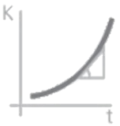



Problem solving needs an overhaul, it needs an interaction of Art, Science and Scale
Consulting
++ Applied Math
- - High Cost
Mu Sigma’s Belief System
Mu Sigma plays in the continuum…
Keyword goes here
Math
Consulting
Business
$$L=\frac{ⅆ\left(K\right)}{ⅆt}$$
Learning-over-knowing
Keyword goes here
Keyword goes here
Extreme
Experimentation
$$X^{2}$$
Behavioral Science & Design Thinking
Product
IT
New IP vs. Old IP
Keyword goes here
Interdisciplinary Perspective
IT
++ Business
++ Applied Math
Technology
Keyword goes here
Nature prefers the Goldilocks state of FLOW, which is a HARMONY between ORDER and ENTROPY
Design Firm
Management Consulting
Research Organization
Laboratory
Industrial Unit
Factory
{
}
implemented at speed
[
]
art
science
done at scale
Additive
effect
Multiplicative
effect
Exponential
effect
Notes:
Mu Sigma plays in the continuum.

Slide 6
Problem solving in an uncertain world has to be highly iterative and non-linear
Analytics Value Chain
HOW IT IS PERCEIVED
1
2
3
4
5
6
7
8
Define Business Objectives
Analytical Design & Data Selection
Data Quality Analysis
Clean & Transform Data
Modeling & Analysis
Acquire Knowledge
Evaluate Results
Deploy Results
HOW IT ACTUALLY IS
1
2
3
4
5
6
7
8
Define Business Objectives
Analytical Design & Data Selection
Data Quality Analysis
Clean & Transform Data
Modeling & Analysis
Acquire Knowledge
Evaluate Results
Deploy Results
Problem Definition
Solution Design
Operationalization

Slide 7

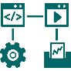
























Mu Sigma’s platforms complement its people and processes to enable the end-to-end analytics value chain
Enabling SaaSaaSaaS…
1
2
muOBI
muUniverse
Problem Definition
Define Business Objectives
Analytical Design & Data Selection
Collaborative
Development
muPDNA
muDSC
Iterative Business Planning & Design
Automated Acceptance Testing
3
4
5
SERVICE TO SOFTWARE
SOFTWARE TO SERVICE
Business Process Flow
Analytical Data Flow
Data Quality Analysis
Clean & Transform Data
Modeling & Analysis
Case studies
Meta Software
Output
Visualization
6
7
EDA
Text Mining
Build & Deploy
Monitoring and Optimization
Acquire Knowledge
Evaluate Results
Data Engineering
Regression
Classification
Solution Design
Segmentation
Optimization
QC
Anomaly detection
Time Series
Forecasting
Release and Manage
Operationalization
8
Deploy Results
muIOT
…using the
Dev Ops Cycle
muFlow
muStream
working in conjunction with clients’ existing infrastructure investments
Analytics Engine
Cloud Infrastructure
ILLUSTRATIVE
Data Layer
FTP
HTTP
APIs
Web Services
Message Queues
Notes:
Mu Sigma plays in the continuum.

Slide 8








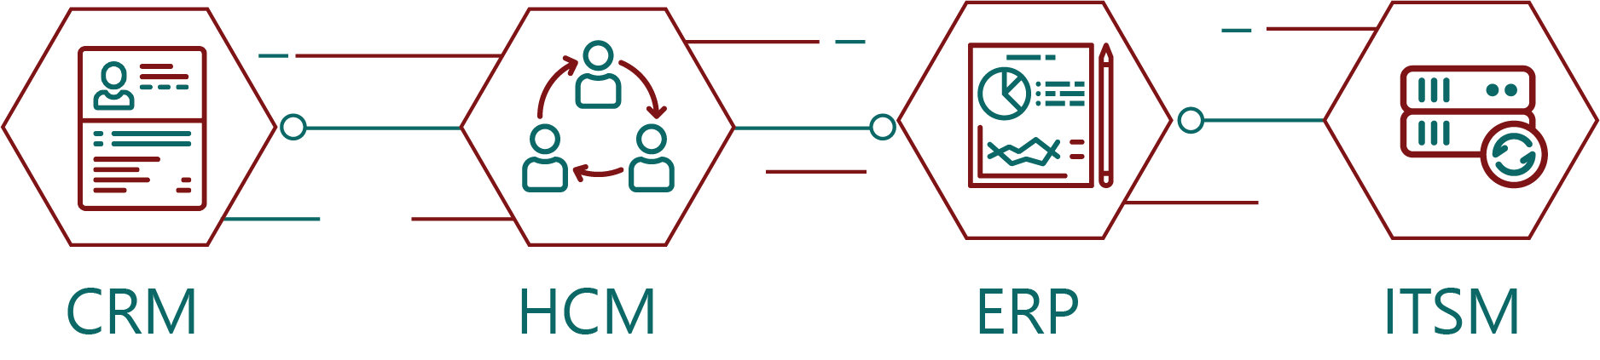







Mu Sigma helps organizations acclimatize to a network world through ecosystems of consciousness
Ecosystems of CONSCIOUSNESS
DECISION
SCIENCES
WEB
MOBILE
CHAT
Navigating complexity,
Achieving Transformation
SYSTEMS OF ENGAGEMENT
mu
Universe
DATA
SCIENCE
muOBI
muAoPS
muPDNA
muDSC
AI, ML, NEURAL NET
ADVANCED ANALYTICS
BUSINESS INTELLIGENCE
Learning Management
System
SYSTEMS OF EXPLORATION
Accelerating Software
muPERCEPT
DATA
ENGINEERING
muGanttLab
CRM
HCM
ERP
ITSM
muGitLab
DataEngineering
FoundationBricks
SYSTEMS OF EVIDENCE
Notes:
Mu Sigma plays in the continuum.

Slide 9
DECISION SUPPORT ECOSYSTEMS
DECISION SCIENCES = DATA SCIENCE + CONTEXT
Presentation/Delivery Layer
Browser | Portal | Office | Websockets | Email | Mobile | API | Services | Message Queues
Consumption Enablement
Learning Management
Process Management
Intelligent Systems | User Personas | Need States | Machine APIs | Insights | Design Thinking Principles | Cockpits | Experimentation
Art of Problem Solving | Project Libraries | Reproducible Research | Collaboration & Reuse | Searchable Archive | Structured Problem Definition
(Batch & Real Time)
Guided Analytical Workflows | BPMN2 | Integration Components | Model Management | Execution | Automation | Rules
DECISION SCIENCES
DECISION SCIENCES
= DATA SCIENCE
+CONTEXT
DATA SCIENCE = DATA ENGINEERING + APPLIED MATH
DATA SCIENCE
Reporting & Analysis
Advanced Analytics
Dashboards & Visualization
DATA SCIENCE
= DATA ENGINEERING
+APPLIED MATH
OLAP (Drill & Explore) | Production Reporting | Exception Reporting | Agile Self Service BI | Ad-Hoc | Search
Optimization | AI | Simulation | Data Mining | Multivariate | Text Mining | Machine Learning
Metrics & KPIs | Alerts | Dynamic Interaction | Aesthetics & Design | Computational Geometry
DATA
ENGINEERING
DATA ENGINEERING
DATA ENGINEERING = DATA + TECHNOLOGY
= DATA
+TECHNOLOGY
Shared Production Layer
Business Contextual Layer
Production Support/ Admin | Help Desk | Repositories | Security | Web Services
Semantics | Ontology | Metadata
Data Integration Layer
Data & HPC Layer
DATA (Crude Oil)
ETL & ELT (Extract, Transform, and Load) | Data Cleansing/Quality | Adapters
SQL | NO SQL | GP-GPU | CLUSTERS | COMPUTE
EVENT PROCESSING | IN MEMORY
3rd Party Data, Applications & Inter-Intra Firewall
ERP/CRM | DATA WAREHOUSE | DATA MART(S) | OLAP | LEGACY DATA | ODS | EXTRACTS | SOCIAL
Notes:
Mu Sigma plays in the continuum.

Slide 10
Agenda
Mu Sigma’s Problem Solving Approach
Analytics in Action
Art of the Possible

Slide 11
Consumer Analytics

Slide 12
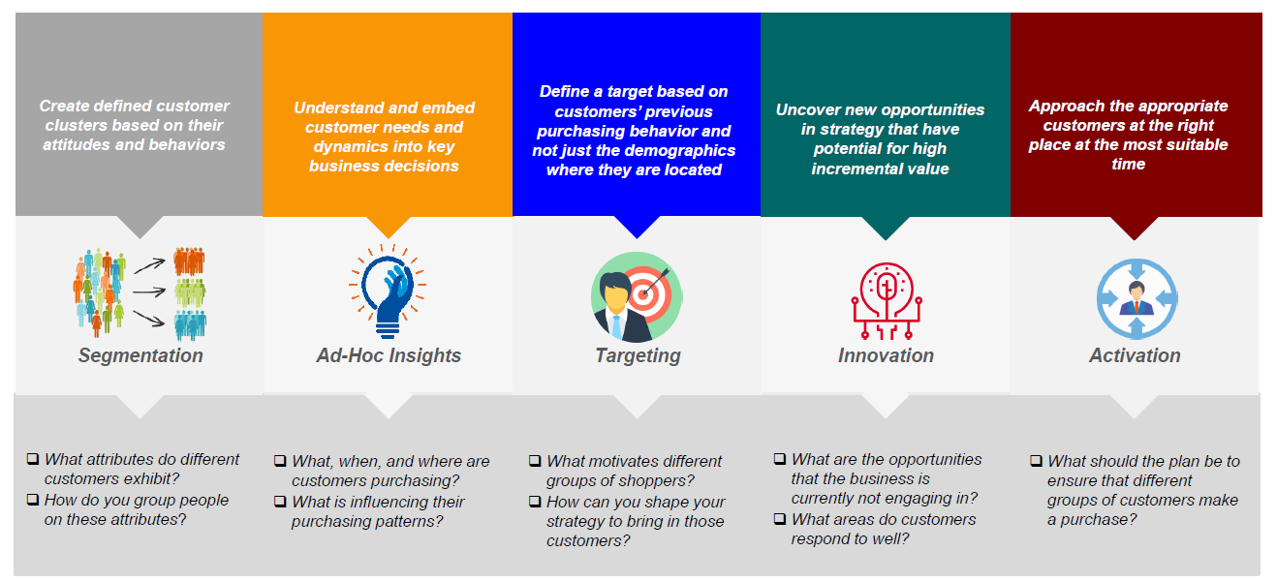
What can you do with Consumer Data?
Information retrieved from: https://www.iriworldwide.com/en-US/solutions/consumer-and-shopper July 19, 2017

Slide 13




Developing a Consumer Behavior laboratory(using ABM) can provide the ability to check market strategy robustness and test different causation factors within the marketplace
With continuous enhancements ABM can support a wide range of business units:
Consumer Check
Develop consumer level insights into market levers and factors that affect the purchase decision
Marketing Team
To attribute advertising impact to each touchpoint and develop marketing strategies
Revenue Growth Management Team
To optimize marketing spend, price, and product availability
Strategy Check
Check the robustness of your actions based on the possible scenarios established through simulation
Sales Teams
To understand the sales drivers at a granular level and optimization trade promotion
Production Planners
To forecast demand accurately and identify the sales drivers
Causation Check
Brand Strategy Team
Test different hypothesis of trend causation factors allowing for proactive decision making
To asses and realign product strategy with overarching brand vision

Slide 14

What is ABM?
An agent based model simulates the actions and interactions of autonomous agents which allows for a view on their effects on the system as a whole. Particularly effective in cases where it is difficult to capture complex interactions in the form of equations
The birds follow three rules:
Alignment, Separation, and Cohesion
"Alignment" means that a bird tends to turn so that it is moving in the same direction that nearby birds are moving.
"Separation" means that a bird will turn to avoid another bird which gets too close.
"Cohesion" means that a bird will move towards other nearby birds (unless another bird is too close).

Slide 15
Consumers are constantly affected by different interacting stimuli within an ever more complex environment
Evoked Set
Historical Behavior
Drinking Moments
Economic Conditions
Product Pricing
Competitor Products
Product Availability
Competitor Marketing
External
Factors
Consumer
Internal
Factors
Marketing Channels
Competitor Pricing
Marketing Message
Temperature
Consumer
Factors
Marketing Frequency
Demographics
Product Options
Social Index

Slide 16






Agent Based Modeling for a Beverage Company
Agent Based Modeling:
How was it implemented at Mu Sigma:
Uses customer demographics/environmental factors/ consumer behavior data
Feedback loops/real world data help validate interactions within the model
Simulate future using ML algorithms
We understood the purchase patterns of consumers from a 2012 launch of a similar product and leveraged the learnings to provide prescriptive, pre-launch insights for a similar market/product
1
Data Wrangling
2
3
4
Analysis / Modeling
Insights
Impact & Recommendations
Outcome
Execution
Identification of important external, consumer, and company factors
Insights through predictive simulation, feedback from real world, exhaustive set of demand parameters
Prescriptive insights into consumer behavior and the overall marketplace for a product launch
Insights about consumer and marketplace behavior can be implemented in marketing, revenue growth management, sales, production planning, and brand strategy
Conclusion: The company was able to predict the sales trends into the future based on consumer interactions, competitive landscape, market development, and activation strategies providing an unparalleled competitive advantage

Slide 17

Consumer behaviour study using video analytics
Video is emerging as the next great data source for companies to learn more about their consumers. While sales, survey, consumer, and household data are insufficient in accurately capturing the impact of shopper marketing initiatives., video analytics gives a much better understanding of your consumers’ preferences and purchase behavior.

Slide 18
Revenue Growth Management
Activation Effectiveness/Flywheel

Slide 19
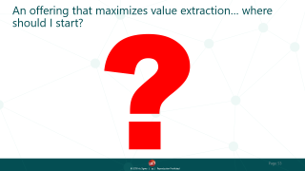
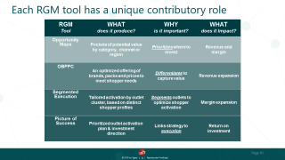
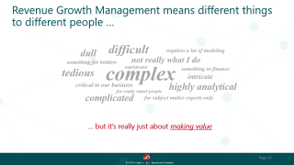
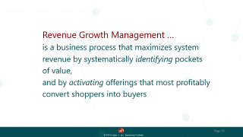



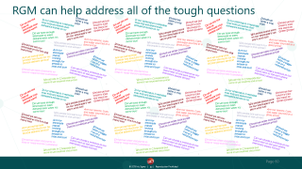
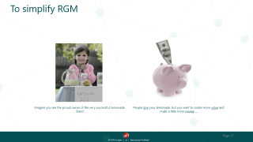



What is Revenue Growth Management?

Slide 20









MARS is behind, but has the opportunity to grow by leveraging data and advanced analytics
Trade Planning Management
Low risk rapid test and learn environments
Precision Promotion
Defining appropriate balance of price spending
Test and Learn
Trade Promotion Optimization
Consumer Promotion Optimization
Spend planning system
Understanding event specific performance
Analytics focused on shoppers
Incremental sales
Personalized pricing
Return on investment
5-7 Years Ago
Present
Next 2-3 years
Decision Flow

Slide 21






Revenue Growth Management
Revenue Growth Management:
How was it implemented at Mu Sigma:
RGM efficiently addresses shopping occasions and consumption moments to incrementally maximize revenue growth
In the FMCG sector, RGM requires a rigorous focus on offering the right pack, price, and promotions for each shopping occasion
Mu Sigma implemented a 3-part strategy covering every aspect of trade and consumer promotions consisting of creating a SSOT, Dashboards, Models, and simulation tools to help the client with their revenue growth management
1
Trade Promotion Management
2
3
4
Activation Effectiveness Model
Promotion Optimization
Impact & Recommendations
Outcome
Execution
Created a single source of truth with internal and external data
Identified sales drivers to enable accurate sales attribution
Simulation tool that outputs thousands of promotional plans as a tailored promotion calendar
Savings of over $10 Million through Mu Sigma’s 3-part RGM strategy
Conclusion:
The client was able to evolve its trade promotion effectiveness and improve the trade efficiency by 2-3% using capabilities developed across TPM, TPO and CPO.

Slide 22





Data to Insights journey- MARS SRM Transformation
Insights to Action to Value
Enabled multiple accounts to generate MAC impact in both US MWC engagement – Meijer, Rite Aid, CVS & Walgreens
Enabled Insights to Value generation (MAC) so far for MWC US:
Direct: Value Identified - $20M;
Indirect: Value Identified - $3.3M; (Through Trade Productivity analysis)
Insights Generation
UK – Insights delivered across -Promo Pricing & Execution
US – Account insights related to Structural Demand, Promo Pricing, Execution & Co-Promotion changes
Insights Automation
UK – Reduction in time to insight through 4* promo efficiency tool
US – Decision augmentation through a custom analytical tool for SRM team
Third Party Tools
Account Planning Tool – Enabled development by utilizing the data foundation & modeling work to provide the baselines & model coefficients
Third Party Analysis
Trade Productivity analysis – Easily accessible harmonized & cleansed data (foundational data library) accelerated the analysis
Model Development
Improvement in quality of decisions through decomposition and deeper understanding of the drivers of Sales
Well defined and codified methodology for competitor mapping and baseline generation
Data Foundation
Cross Dataset insights generation enabled using the Data Library
Reduced time to insight by significant reduction in staleness of data
Reusable & Sustainable process in place to acquire, integrate, analyze & store 2M+ rows of data for Mars

Slide 23
Social Media Analytics

Slide 24









Social Media Analytics aid in “giving people what they want” and being receptive to shifts in the market throughout a product’s lifecycle
Where do I innovate?
Identify the right consumer segment
Increase brand awareness
What is the right set of products?
Product Development
What do people think of KIND?
What should be my campaign strategy?
Product Launch
What do people think of my competition?
How much do people trust KIND?
Post Launch
How to re-innovate to capitalize growth?
Notes:
Conceptualization/pre/post/measurement

Slide 25


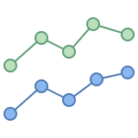

Identifying Trends using Social Media Analytics
Social Media Analytics:
How was it implemented at Mu Sigma:
The process of gathering and analyzing data from social networks such as Facebook, Instagram, and Twitter to enable informed and insightful decision making
Mu Sigma gathered the data from various social media networks such as Facebook, Instagram, Twitter, Etc. in order to identify and asses trends to inform varied critical business decisions for a F&B company
1
Identifying Current Trends
2
3
4
Understanding the current State of Trends
Assessing the Future of the Trend
Impact & Recommendations
Outcome
Identified up and coming trends of interest for CPG industry
Prioritized ranking of focus areas/trends to understand social media viral events and sentiment analysis
Built a predictive framework to provide insights into trend life-stages and upcoming trends to understand market potential
Higher level of future trend prediction, customer engagement and revenue prediction for the selected trend
Execution
Conclusion: The F&B company was able to acquire another company to maximize market share and penetration

Slide 26



Identifying Social Media Influencers
Social Media Analytics:
How was it implemented at Mu Sigma:
The process of gathering and analyzing data from social networks such as Facebook, Instagram, and Twitter to enable informed and insightful decision making
Mu Sigma helped the client identify key influencers who can become brand advocates for a new product to be launched
1
Data Wrangling
2
3
4
Analysis / Modeling
Insights
Impact & Recommendations
Gathering tweets promoting products from social media influencers
Score assigned on factors such as author, number of followers, profession
Influencers who match criteria are selected and are given a demo product for review and buzz creation
Resulted in increased traffic to web page and 13% increase in sales
Conclusion: The company was able to increase their NPS by 12%, leading to expansion of prospective consumers

Slide 27




Trust Sensing
Random Forest Model:
How was it implemented at Mu Sigma:
A random forest model was implemented to help MARS not only improve their trust scores but also take action into improving scores through powerful insights
We processed the data, used POS tagging, and did phase extraction to arrive at our random forest model
1
Data Wrangling
2
3
4
Analysis / Modeling
Insights
Recommendations
Outcome
Execution
Understanding the trust score/reputation index data
Trust calculation model which calculates weekly and yearly Trust Scores
Identifying each theme that contributes to the Trust Score
Important factors that provide powerful insights which help improve trust scores
Conclusion: MARS was able to identify the key levers of trust and was able to take actionable decisions to improve consumer trust and take remedial measures

Slide 28
Agenda
Mu Sigma’s Problem Solving Approach
Analytics in Action
Art of the Possible

Slide 29
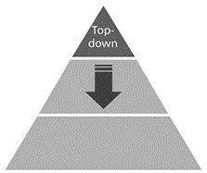
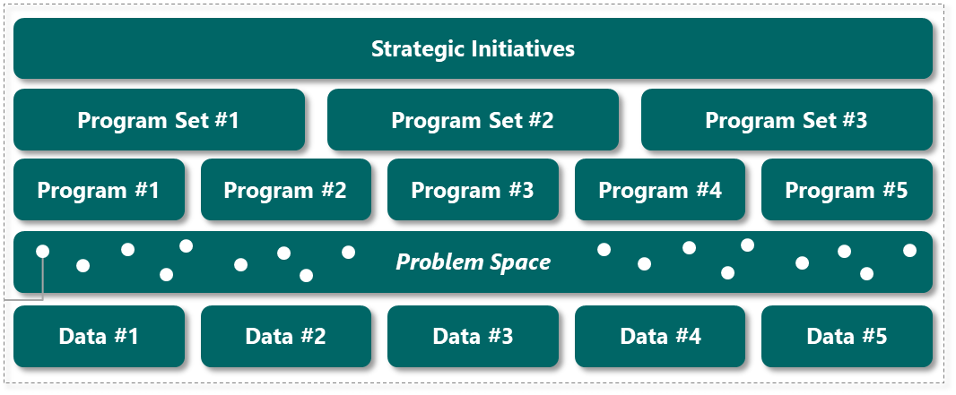





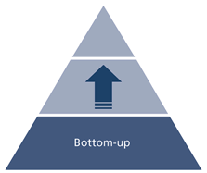
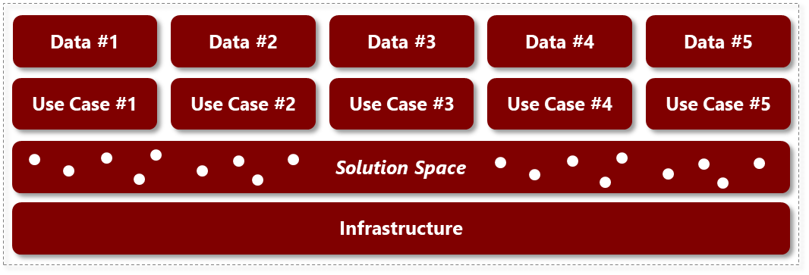
There is a need to understand the process and approach of how to move tactically while creating value at scale
“What do we need to do?”
Investment
GROWING DATA NEEDS
Program Space
Program Implementation @ SCALE
Feasible Programs
P1
P2
P3
Data Space
Reassess
INCREASING DATA USES
“How do we enable?”

Slide 30
We can approach problem solving holistically by understanding latent connections that exist between problems
Basket Analysis
Consumer Propensity
Target Consumer Identification
Consumer Segmentation
Campaign Design
Trendspotting
Novelty seeking Index
Buzzword Identification
Consumer Analytics
Regional pricing
Social Media Analytics
Transponding
Product Adoption
Repurchase and Loyalty Analysis
Trade Promotion Optimization
Influencer Identification
Social Index
Brand Awareness Index
Sentiment Analysis
Revenue Growth Management
New Product Innovation
Price
Corridor
Price Elasticity
Trust Sensing
Channel sales optimization
Distribution optimization
Cost reduction
Sales channel optimization

Slide 31















Art of the Possible
Products and
Innovation
Influencer
Identification
Price and
Promotion
Perfect Store
and RTM
Competitive
Intelligence
Consumer
Segmentation
Brand Awareness
Switching
Analysis
Trend
Measurement
Product
Portfolio/Channel
Scenario
Planner
Sales Driver and Trade
Trust and
Sentiment Study
Campaign
Design

Slide 32
Machine Learning

Slide 33
Content
What is Machine learning?
Why Machine learning?
Machine Learning Opportunities for KIND

Slide 34


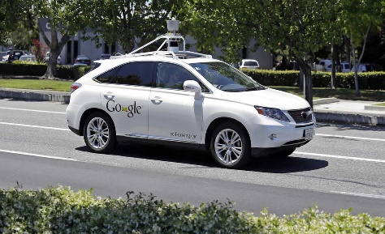
Machine learning involves iterative learning from new and constantly changing data for improved results
Traditional Computing
Machine Learning
Data
Data
Program/ Algorithm
Program/ Algorithm
Output
Output
Comprised of algorithms that perform a specific task
Algorithms self learn and some of them modify themselves based on the feedback that they receive
Program/ Algorithm
Example : Self driving car
The algorithm is trained to recognize the objects that it might encounter on the road
The learning is improved iteratively by a continuous feedback process
Leads to better recognition with more learning.
New Data
Learn from mistakes

Slide 35


Developments in the field of computer technology and especially AI has led to increased applicability of machine learning solutions
More computational power and memory(GPU performance has improved and price has come down leading to cost efficient options)
Growing flood of different data(44 zettabytes by 2020)
New and more efficient algorithms(For Example: Field of algorithmic image classification has been revived with the advent of Convolutional Neural Networks)
Growing IOT based devices (212B connected devices by 2020)
Inflexible Manual Effort Expertise
Business intuition + Statistics Only
Machine Learning
Solution
Business Problem
Low maintenance Real time solution Better and reliable results

Slide 36
Contrary to common understanding, Machine Learning is different from statistics with minor overlap between the two
Statistics is the study of the collection, organization, analysis, interpretation and presentation of data
Machine learning is a branch of AI concerning the construction and study of systems that can learn from the data.
Theory
Discovery
Statistics
Machine
Learning
Deductive
Inductive
Inference
Learning
Experiment Design
Generalization
Sampling
Numerical
Math / Stat / Econ
Computer Science
Techniques
Statistics | Both | Machine Learning
Time Series Forecasting | Linear Regression | Random Forest
Linear Discriminant Analysis | Logistic regression | Neural Networks
ANOVA | Factor Analysis | Naïve Bayes
Survival Analysis | Principal Component Analysis | Regression Tree

Slide 37
Plethora of machine learning algorithms have been implemented across multiple areas
Supervised Learning
Unsupervised Learning
Classification
Clustering
Naïve Bayes
Decision Tree
Support Vector Machine
Logistic regression
Random Forest
K- Means
Hierarchical
DBSCAN
Neural Nets
Discrete
Regression
Dimension Reduction
Linear Regression
Multinomial Regression
Elastic Net Lasso
Ridge Regression
PCA
Kernel Approximation
Independent Component Analysis
Continuous

Slide 38
KIND has tremendous opportunities to benefit from machine learning applications
Time Series Forecasting/Regression -
Improved forecasting using ensemble approach for better planning of sales activities
Regression/Dimension Reduction
Clustering – Machine Quality
Maintenance
Finding the best metrics to explain sales will generally involve a mix of the variables which are identified using dimension reduction(PCA/Factor Analysis)
To cluster and identify at-risks machines for proactive and cost effective maintenance
Regression – Manufacturing
Process Control
Clustering - Store/Customer
ML algorithms to optimize production, and control for quality
Create and analyze the various store/customer clusters for targeted marketing
Classification - Video Analytics
Analysis of video feeds inside store (using Neural Nets) can help KIND gauge the response to a campaign

Slide 39
Mu Sigma Business Case Studies
Price Simulation Tool
Created pricing tool for software company in which end users of tool (automobile dealers) can simulate price points based on inventory.
Neural network/ multilayer perceptron model, which led to incremental revenue of ~13% and improved customer up-sell of ~8%
Customer Satisfaction & Experience Management
Helped e-Commerce client understand customer journey and satisfaction to predict revenue at risk
Model used unsupervised text analytics, NPS, and a combination of ML and active learning to classify real time unstructured data streams
Video/ Image Analytics
Solutions for client in which video feeds use Deep Nets, Optical Flow, etc. for human recognition and tracking to measure business metrics (i.e. customer interactions, dwell time, etc.)
Real time shelf availability solutions using contour detection, image subtraction, etc. to detect changes in aisle
Up-Sell, Cross-Sell Opportunities
Helped gaming console/ service provider measure customer engagement across gaming platform in terms of usage, effectiveness of ads, etc.
Identified optimal customer segments for targeted activities as well as growth opportunities worth 63% of current services revenue

Slide 40
Mu Sigma Business Case Studies, cont’d
Fraud Detection and Rules Generation
Created a fraud scheme repository for banking client that is able to proactively detect loss potential from reconciliation issues in general ledger transactions
Reduced overall manual effort, increased efficiency, and saved up to $4M annually for client
Agent Interactions in Auction Environment
Helped world’s largest social network understand event impact by modeling agent interactions in an auction environment
An User interface was developed to facilitate the model which mimicks real life scenarios by populating the advertisers from actual distributions
Recommendation Engines
Helped a banking client to migrate their recommendation engine to Big Data infrastructure and then enhanced the algorithm
Identified volume reduction opportunities and incorporated them to override data expansion though 3 phases
Anti-Malware Analysis
Helped leading Banking client to strengthen their security against malware attacks in order to protect their application and data servers
A strong network classifier was build using Random Forest and logistic regression, which allowed real-time detection and dynamic enhancement

Slide 41
Appendix

Slide 42
Data Elements

Slide 43
High level data requirement across the universe of problems
Theme | Problem | Data Elements
Social Media Analytics | Trendspotting, Transponding, and Campaign Design | Social Media data (FB, IG, YouTube, and etc.) Sales (Nielsen, IRi)
 | Sentiment Analysis and Trust Score | Kantar data
 | Influencer Identification | Social Media data (FB, IG, YouTube, and etc.) Klout Scores
 | Buzzword Identification | Social Media data (FB, IG, YouTube, and etc.)
 | New Product Innovation | Social Media data (FB, IG, YouTube, and etc.)
Consumer Analytics | Consumer Propensity Analysis, Target Consumer Identification, and Consumer Segmentation | Social Media data Shoppercart data Demographics Survey data Sales data
 | Basket Analysis/ Repurchase and Loyalty Analysis | Shoppercard Data
 | Brand Awareness Index | Marketing data Marketing consumption data Survey data
 | Novelty Seeking Index/ Product Adoption/Social Index | Survey data Sales data Demographics data Social Media data

Slide 44
High level data requirement across the universe of problems
Theme | Problem | Data Elements
Revenue Growth Management | Regional Pricing | Nielsen Syndicated Sales Data Demographic Information PPP(Purchasing Power Parity) data
 | Pricing Corridor | Nielsen Syndicated Sales Data Brand View (Promo Data) Promo Calendar
 | Trade Promo Optimization | Nielsen Syndicated Sales Data Brand View (Promo Data) Promo Calendar
 | Distribution Optimization | Nielsen Syndicated Sales Data Demand planning data
 | Sales Channel Optimization | Nielsen Syndicated Sales Data Consumer Data Brand View (Promo Data)
 | Cost Reduction | Nielsen Syndicated Sales Data Internal Logistics data Internal Finance Data(COGS/TI)

Slide 45
Universe Example

Slide 46
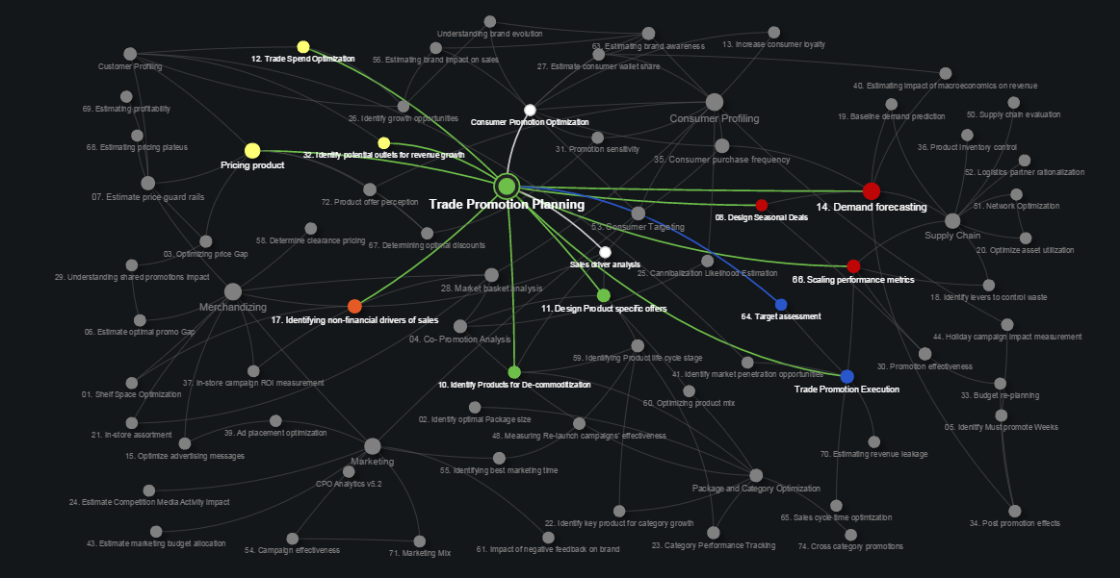
muUniverse

Slide 47
Consumer Buying Cycle

Slide 48





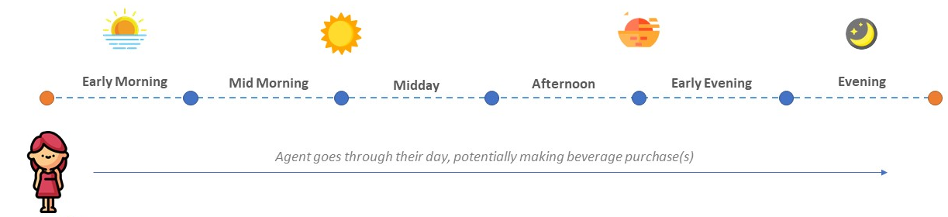






There are a multitude of factors that affect a consumer’s purchase decision
Publicly available temperature data
Drinking moment to beverage category
Heuristic rules on Segment and part of day to drinking moment
Loyalty Index
Leads to increase in Product Adoption Level…
Promotions and In store execution
Social Index
… leads to higher probability of next purchase
Brand Purchase
Brand Awareness
Increases brand awareness
Competitor pricing and promotion
Marketing spends

Slide 49
RGM

Slide 50
Revenue Growth Management means different things to different people …
difficult
dull
requires a lot of modeling
not really what I do
something for bottlers
complex
tedious
sophisticated
something in finance
intricate
critical to our business
highly analytical
for really smart people
complicated
for subject matter experts only
… but it’s really just about making value

Slide 51


To simplify RGM
Imagine you are the proud owner of the very successful Lemonade Stand
People love your lemonade, but you want to create more value and make a little more money …

Slide 52
Revenue Growth Management … is a business process that maximizes system revenue by systematically identifying pockets of value, and by activating offerings that most profitably convert shoppers into buyers

Slide 53
An offering that maximizes value extraction… where should I start?
?

Slide 54
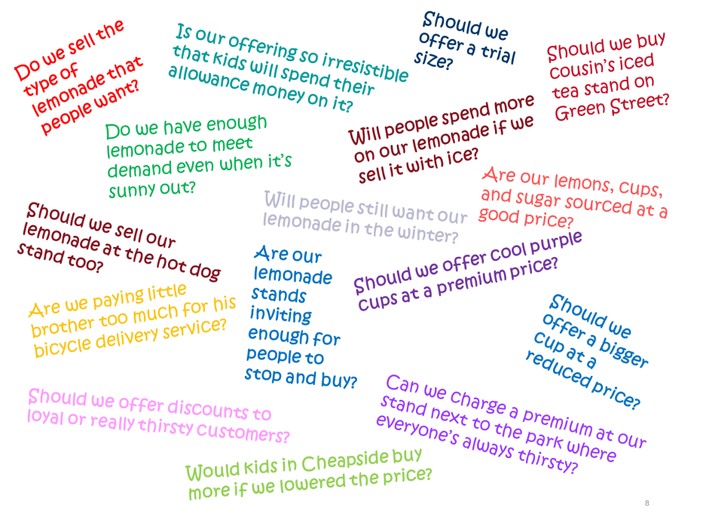
RGM can help address all of the tough questions

Slide 55
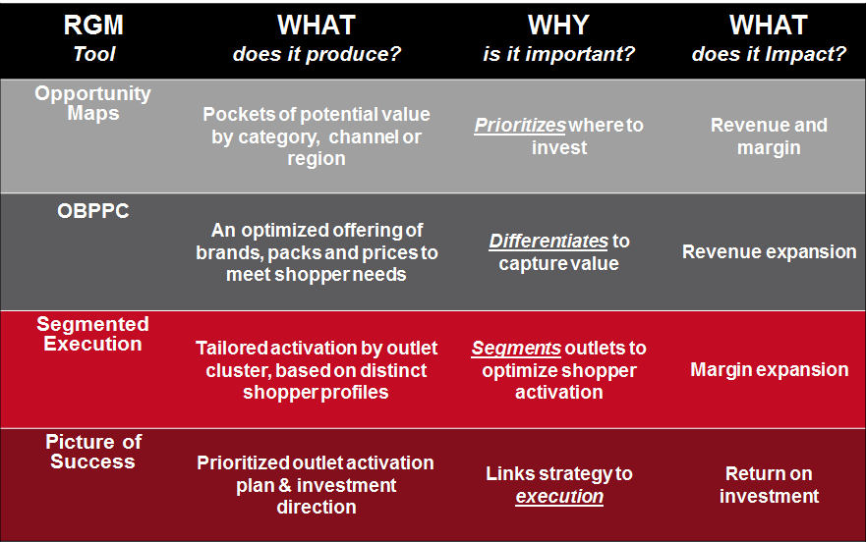
Each RGM tool has a unique contributory role

Slide 56
An Effective RGM Engine will leverage a combination of descriptive, predictive, and prescriptive analytics
Strategic Revenue Management
Trade Capabilities
Retail Execution
Customer Decision Support
Consumer Engagement
Analytical Capabilities Required
Sources of Growth
Scenario Planning
Sales Driver Analytics
Margin Optimization
Personalization
Store Analytics

Slide 57
Brand Awareness

Slide 58
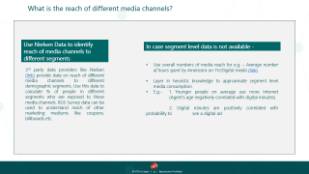
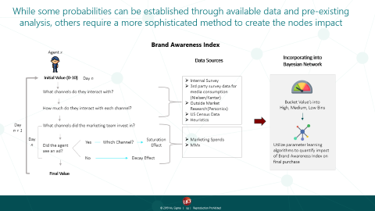
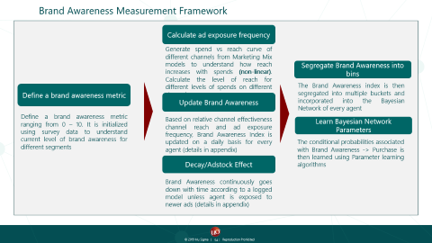
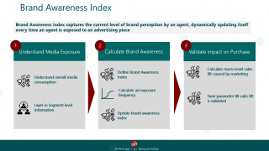
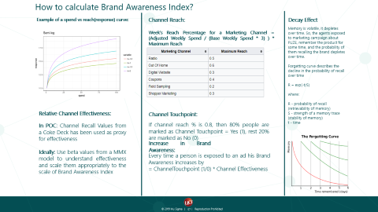

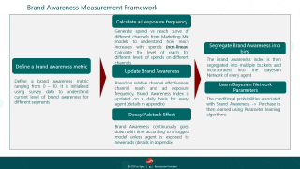


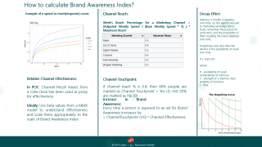
Brand Awareness Index

Slide 59


Brand Awareness Index
Brand Awareness Index captures the current level of brand perception by an agent, dynamically updating itself every time an agent is exposed to an advertising piece
1
2
3
Understand Media Exposure
Calculate Brand Awareness
Validate impact on Purchase
Calculate macro level sales lift caused by marketing
Define Brand Awareness Index
Understand overall media consumption
Calculate ad exposure frequency
Tune parameter till sales lift is validated
Layer in Segment level information
Update brand awareness index

Slide 60
Brand Awareness Measurement Framework
Calculate ad exposure frequency
Generate spend vs reach curve of different channels from Marketing Mix models to understand how reach increases with spends (non-linear). Calculate the level of reach for different levels of spends on different channels
Segregate Brand Awareness into bins
Define a brand awareness metric
The Brand Awareness index is then segregated into multiple buckets and incorporated into the Bayesian Network of every agent
Update Brand Awareness
Define a brand awareness metric ranging from 0 – 10. It is initialized using survey data to understand current level of brand awareness for different segments
Based on relative channel effectiveness channel reach and ad exposure frequency, Brand Awareness Index is updated on a daily basis for every agent (details in appendix)
Learn Bayesian Network Parameters
The conditional probabilities associated with Brand Awareness -> Purchase is then learned using Parameter learning algorithms
Decay/Adstock Effect
Brand Awareness continuously goes down with time according to a logged model unless agent is exposed to newer ads (details in appendix)

Slide 61
What is the reach of different media channels?
Use Nielsen Data to identify reach of media channels to different segments
In case segment level data is not available -
Use overall numbers of media reach for e.g. – Average number of hours spent by Americans on TV/Digital media (link)
Layer in heuristic knowledge to approximate segment level media consumption
E.g.- 1. Younger people on average use more Internet (Agent’s age negatively correlated with digital minutes)
2. Digital minutes are positively correlated with probability to see a digital ad
3rd party data providers like Nielsen (link) provide data on reach of different media channels to different demographic segments. Use this data to calculate % of people in different segments who are exposed to these media channels. BGS Survey data can be used to understand reach of other marketing mediums like coupons, billboards etc.

Slide 62



While some probabilities can be established through available data and pre-existing analysis, others require a more sophisticated method to create the nodes impact
Brand Awareness Index
Agent x
Data Sources
Incorporating into Bayesian Network
Initial Value (0-10)
Day n
Internal Survey
3rd party survey data for media consumption (Nielsen/Kantar)
Outside Market Research(Personicx)
US Census Data
Heuristics
What channels do they interact with?
Bucket Value’s into
High, Medium, Low Bins
How much do they interact with each channel?
Day
n + 1
What channels did the marketing team invest in?
Marketing Spends
MMx
Day
n
Yes
Which Channel?
Saturation
Effect
Did the agent see an ad?
Utilize parameter learning algorithms to quantify impact of Brand Awareness Index on final purchase
No
Decay Effect
Final Value

Slide 63
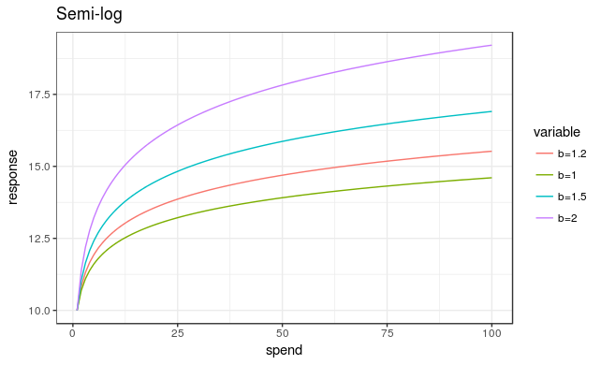
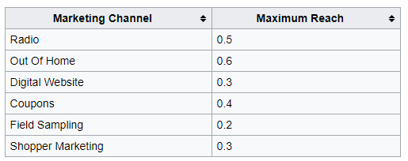
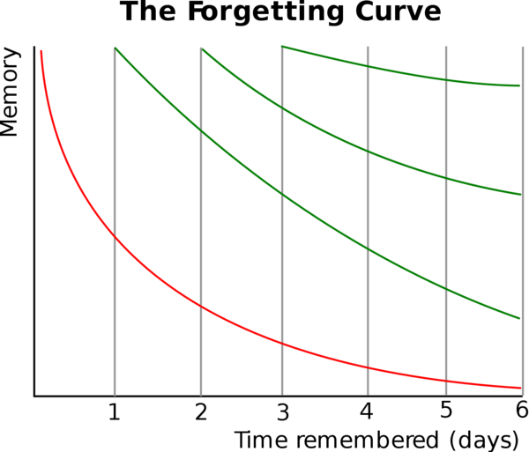
How to calculate Brand Awareness Index?
Example of a spend vs reach(response) curve:
Channel Reach:
Decay Effect
Week's Reach Percentage for a Marketing Channel = (Adjusted Weekly Spend / (Base Weekly Spend * 3) ) * Maximum Reach
Memory is volatile, it depletes over time. So, the agents exposed to marketing campaign about FUZE, remember the product for some time, and the probability of them recalling the brand depletes over time.
Forgetting curve describes the decline in the probability of recall over time
R = exp(-t/S)
where:
R - probability of recall (retrievability of memory)
S - strength of a memory trace (stability of memory)
t - time
Relative Channel Effectiveness:
Channel Touchpoint:
In POC: Channel Recall Values from a Coke Deck has been used as proxy for effectiveness
Ideally: Use beta values from a MMX model to understand effectiveness and scale them appropriately to the scale of Brand Awareness Index
If channel reach % is 0.8, then 80% people are marked as Channel Touchpoint = Yes (1), rest 20% are marked as No (0)
Increase in Brand Awareness:
Every time a person is exposed to an ad his Brand Awareness increases by
= ChannelTouchpoint (1/0) * Channel Effectiveness

Slide 64
PERFECT STORE UK

Slide 65

Summary
Executive Summary
KEY INSIGHTS
Temporary Secondary Displays (TSD) have the most significant impact on sales volume followed by Transaction Zones amongst the Hot Zones
A focus on improving Signage scores in various zones is the single most important factor to drive sales volume
By improving Signage in Temporary Secondary Displays and Transaction Zones, MARS can see a sales volume increase of 5% or higher

Slide 66



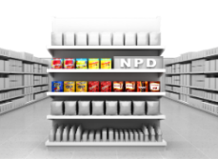


Findings & Insights
Key Drivers of Sales at a Hot Zone Level
Impact*
7X
A focus surrounding the
improvement of signage scores will help drive sales volume
3X
2.2X
Temporary Secondary Display Signage
Transaction Zone Signage
Temporary Secondary Display Location
*The impact has been calculated with Holiday as base
Transaction Zone
Temporary Secondary Display
Signage
Location
TSD – Temporary Secondary Display ;TZ – Transaction Zone; PSD – Permanent Secondary Display

Slide 67

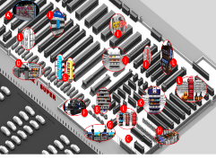
Findings & Insights
A small improvement of signage scores will often cause a greater impact than a larger improvement of other ALPS metrics in similar or different zones
Temporary Secondary Display
Transaction Zones
Permanent Secondary Display
Signage
Position
Signage
1
2
Location
1
Signage
3
1
METRIC
CHANGE IN SCORES
+ 0.10
Ex : ( 0.3 -0.4)
+ 0.20
Ex : ( 0.5 -.7)
+ 0.20
Ex : ( 1 – 1.2)
+ 0.10
Ex : ( 0.3 – 0.4)
+ 0.10
Ex : ( 0.3 – 0.4)
VOLUME LIFT OPPORTUNITY
6 %
2 %
1 %
5 %
2.5 %
Changes of ALPS scores of .1 to .2 points can result in sales growth volume of 3 - 5%

Slide 68
LUE

Slide 69
Suggested operating model- Summary
Vision - Deliver short term productivity gains and lay the foundation for long term success(broader strategic capabilities) utilizing advance analytical capabilities
Organization - Implement a logical unit of ecosystem (LUE) model with initial set up and scale with Mu Sigma to embed in business for steady future state. Dedicated core team with flex capacity to run analytics in program way with flexible capacity and knowledge retention
Data & Systems - Migrate from a siloed and Adhoc model, towards a harmonized, reusable data assets with self serve capabilities (Data engine)
Exploration and Exploitation - Develop analytical capabilities for high value and core competency business functions, with faster ideation to exploration to exploitation cycle
Internal vs External - Build ecosystem of people by training across skillset, toolset and mindset (slide pending)
Focus on people, process and platform rather than only people

Slide 70
Our model for delivering transformational projects
Idea Generation
MVP Execution
Socialize success
Scale
Idea Generation
MVP Execution
Socialize success
Scale
User Centric Approach
Reapply MVP learnings to new markets, segments and brands
Optimize with
Consumer Group through feedback sessions
Stakeholder Interviews
Delivery using Agile methodology
Approach Taken
Project Management using Azure DevOps and Jira
Develop knowledge repository
Design Thinking Workshops
Identify cross functional champions to drive consumption
Daily, weekly and monthly business reviews
Build inter-connections between stakeholders
Transformation
Explore
DIPP Evaluation
Reusable data library and attribution models
Data Foundations
Benchmarking and Mu3Ds
Deliverables
Timelines and estimates
Private EoC
Analytical models
User documentation
Customizable code and UIs with standardized KPIs
Mock-ups and solution design
User Stories
Dashboards
Training sessions and training videos
Technical documentation

Slide 71
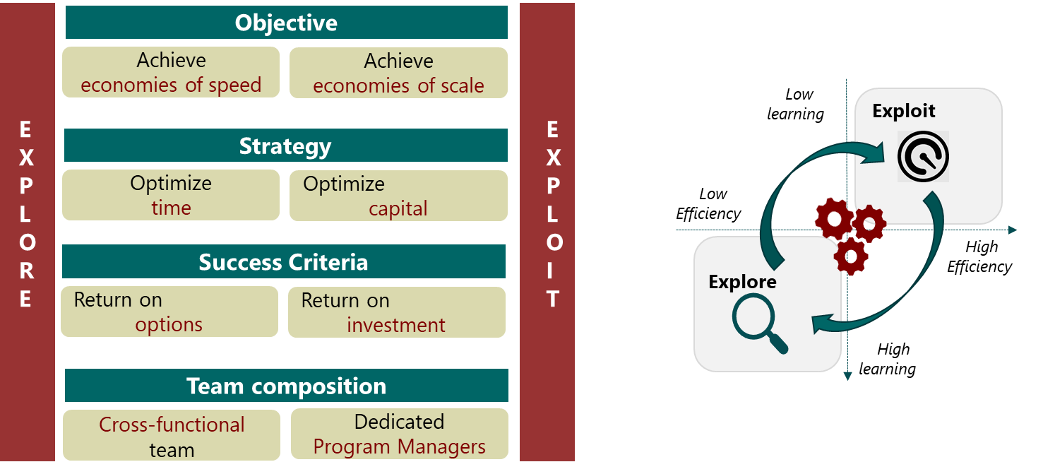


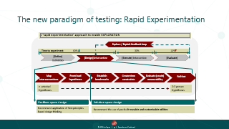
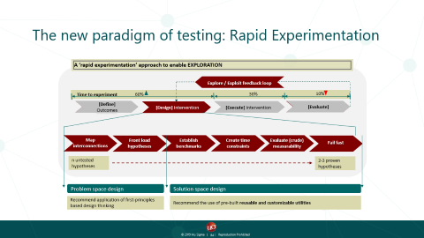
Explore and Exploit
Explore and Exploit
EXPLORE & EXPLOIT
Rapid experimentation necessitates organizations to develop a conscious EXPLORE & EXPLOIT mindset
EXPLORE
rapidly
EXPLOIT
efficiently
Click on this

Slide 72




A holistic ecosystem of people, process and technology platforms will help transform the business
People, Process & Platform
People, Process & Platform
People
Teams of Decision Scientist
Analytical translators, who are working with business units , the digital transformation team, finance and each specific person respective part
Platforms
Process
Supporting mechanisms for systematizing and operationalizing activities
Leveraging the learnings from other projects in the ecosystem
Strategies for harmonizing the problem solving journey
Systems scalability guidelines
Scalable operation management
Governance and Feedback Mechanisms

Slide 73



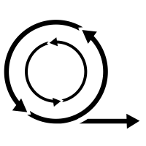
Organizational best practices that need to be implemented for success
Organization
Cross-Functional Team
The teams need to work on the intersection of Math , Business and Technology
User Centricity
A zero distance will be maintained with the problem owner, to consistently work on the business feedbacks
Consistent learning and knowledge retention
Each problem solved should create a template which may be used for scaling
Agile Methodology
The problems shall be solved to get quick turnarounds and multiple iterations to get the best results out

Slide 74
Mu Sigma’s positional advantage allows it to be an effective transformation Sherpa across Fortune 500 organizations
Organization
Economies of Scale
Economies of Speed
People based solution designed to solve specific problems
Return on Investment mindset
Exploring for efficiency through right questions
Building products for solving analytical problems
Build ecosystem of people, processes and platform to be Transformation Sherpa
Return on Option mindset
Efficient exploration by reducing cost per question
Building meta software across problem definition, solution design and operationalization space
Economies of Scope
What gives us our positional advantage?
Tools & Products
Types of complexity
Skills
Problems Solved across industries
Types of data
The above transition is enabled by a Logical Unit of Ecosystem that will lead to:
Tracing the undealt complexity to dealt complexity
Designing and developing capabilities across people, process and platform
Co-designing the economies of scope to reduce cost per question leading to speedy execution

Slide 75
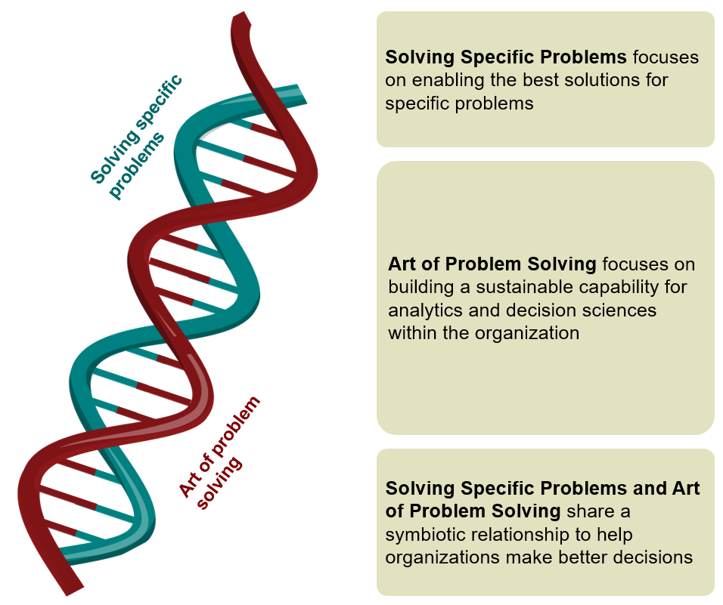



LUE model allows customers to build capabilities for the long-term while creating impact in the short term
Organization
LUE Model Overview
AoPS & SSP Harmony
LUE Model Benefits
People
Short Term
Quickly design and experiment with business stakeholders
AoPS platform licenses providing artefacts - muOBI, muUniverse, muPDNA & muDSC
Run multiple threads with the team
Access to EoC assets and accelerators to shorten time to value
Long Term
Reduction of uncertainty and increase in flexibility of scope and scale
Outcome focused on pure value add to business
Cross-industry learnings from Mu Sigma ecosystem
Customized workshops and trainings conducted by Mu Sigma University
3,500 strong decision sciences community with capability across Math, Business, Technology, Behavioral Sciences and Design thinking
Client site and India Innovation center decision scientist will be distributed across dedicated, available and flexible pool
LUE
Platform
Processes & Training
AoPS (Art of Problem Solving) artefacts for problem solving – muOBI, muUniverse, muPDNA, muDSC
EoC (Enablers of Confidence) to accelerate solutioning
Accelerating Software to increase speed and reduce execution time
Workshops formulated on design thinking principles – AoPS workshop
Training programs across skillset, toolset and mindset through Mu Sigma as a University MS@U
Executive Leadership planning and training programs to co-create the Analytical Roadmap
Solving specific problem will help in creating short term solutions
Art of Problem Solving allows us capability building over long term

